Slide 1
Classification

Slide 2
Classification
Classification is a task where we assign a discrete label to a data instance. For example, classifying emails as spam or not spam.
There are variations of classification:
Binary classification: Target space consists only two classes. Eg: A classifier to identify if there is a dog in a picture or not. Yes or no.
Multi-class classification: Target space consists of more than two classes. Eg: A classifier to identify a dog breed from a picture. There are several possible breeds.
Multi-class multioutput classification: There are more than one targets to predict. Eg: Identify the dog breed and also it’s color.

Slide 3
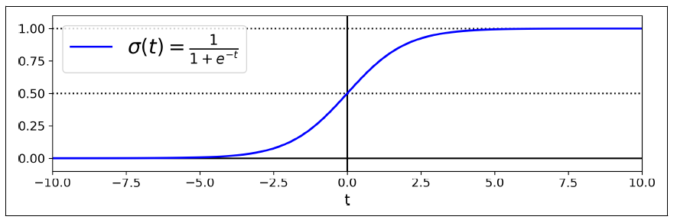


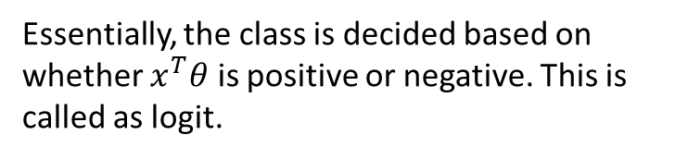
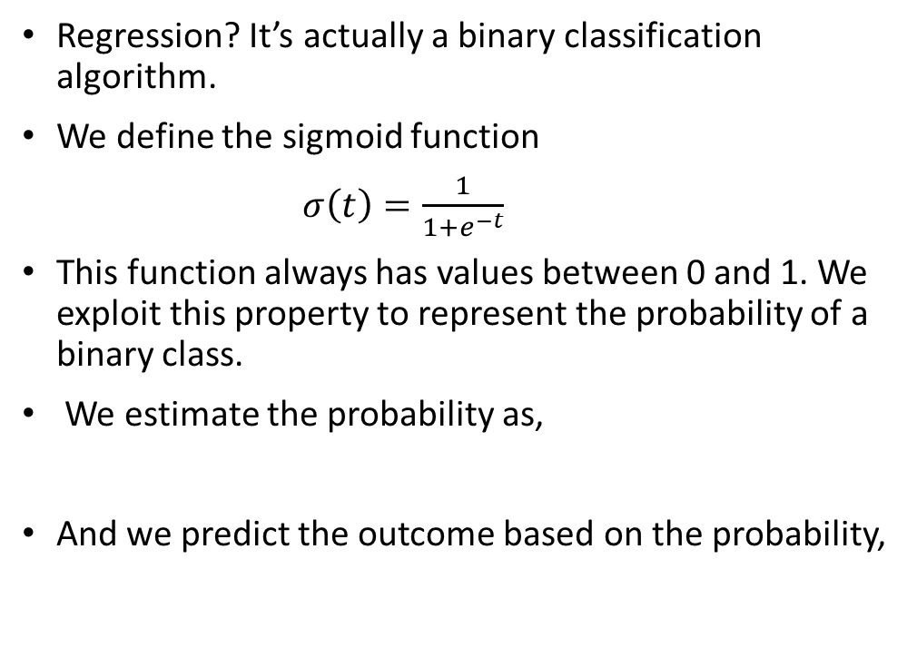
Logistic Regression
Regression? It’s actually a binary classification algorithm.
We define the sigmoid function
$σ\left(t\right)=\frac{1}{1+e^{−t}}$
This function always has values between 0 and 1. We exploit this property to represent the probability of a binary class.
We estimate the probability as,
And we predict the outcome based on the probability,
Essentially, the class is decided based on whether $x^{T}θ$ is positive or negative. This is called as logit.

Slide 4
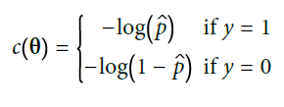


Logistic Regression
Cost function
Total cost for all training samples,
There is no closed for solution for this, but we can solve it using gradient descent.
The gradient of the cost function is below, It is quite similar in form to the linear regression.

Slide 5
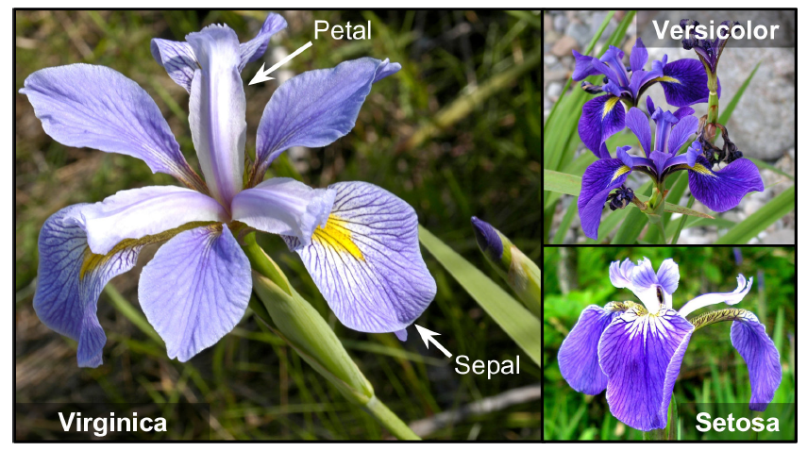
Iris
Classification problem with 4 attributes/features
Petal length
Petal width
Sepal length
Sepal width
We need to identify the type of flower
Iris Virginica
Iris Versicolor
Iris Setosa

Slide 6
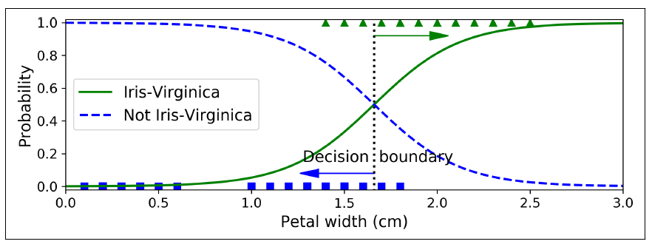
Iris
Let’s consider predicting whether a flower is Virginica or not based on only the petal width.
We only need probability of positive class. The negative class is just the complement since the sum of probabilities is 1.
Decision Boundary: [1.61561562]
The dashed line is called as the decision boundary. It is the best possible split that discriminates between two classes.

Slide 7
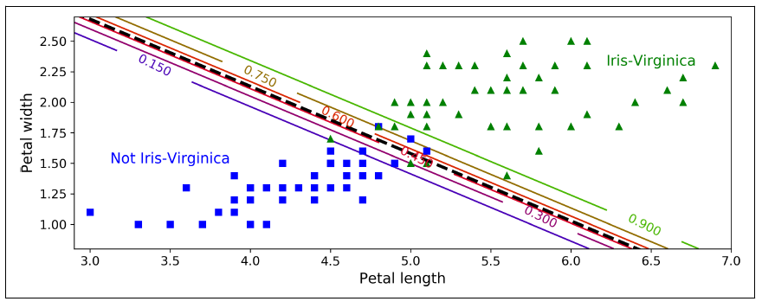
Iris
We can also consider the petal length for the prediction.
We get a linear separation between the two regions.
At the line, the logit has a value of 0.5.
This can be extended to higher dimensions.

Slide 8
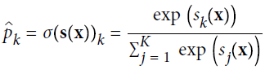
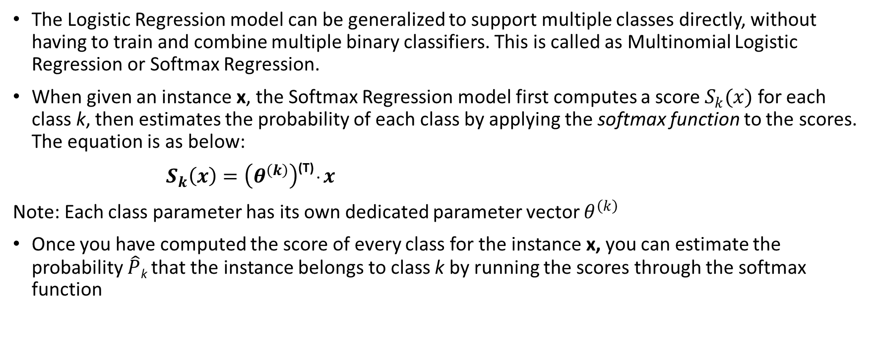
Softmax Regression
The Logistic Regression model can be generalized to support multiple classes directly, without having to train and combine multiple binary classifiers. This is called as Multinomial Logistic Regression or Softmax Regression.
When given an instance x, the Softmax Regression model first computes a score $S_{k}(x)$ for each class k, then estimates the probability of each class by applying the softmax function to the scores. The equation is as below:
$S_{k}\left(x\right)=\left(θ^{\left(k\right)}\right)$^{(T) .} $x$
Note: Each class parameter has its own dedicated parameter vector $θ^{\left(k\right)}$
Once you have computed the score of every class for the instance x, you can estimate the probability $\hat{P}$_{k} that the instance belongs to class k by running the scores through the softmax function

Slide 9


Softmax Regression
Making predictions: We have k probabilities for k classes. The outcome is the one with the higher probability.
Cost Function: Similar to logistic regression cost function. It’s called cross-entropy.

Slide 10
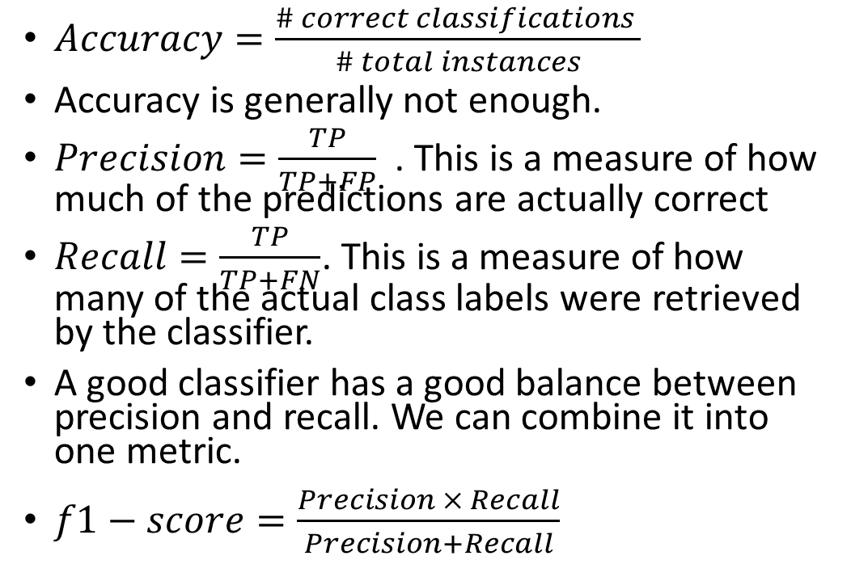
Performance Metrics
$Accuracy=\frac{\# correct classifications }{\# total instances}$
Accuracy is generally not enough.
$Precision=\frac{TP}{TP+FP}$ . This is a measure of how much of the predictions are actually correct
$Recall=\frac{TP}{TP+FN}$. This is a measure of how many of the actual class labels were retrieved by the classifier.
A good classifier has a good balance between precision and recall. We can combine it into one metric.
$f1−score=\frac{Precision × Recall}{Precision+Recall}$
Confusion Matrix
 | Class 0 | Class 1
Predicted 0 | True Negative | False Negative
Predicted 1 | False Positive | True Positive

